Slide 1

Weekly Update 10
Sarang Deb Saha

Slide 2
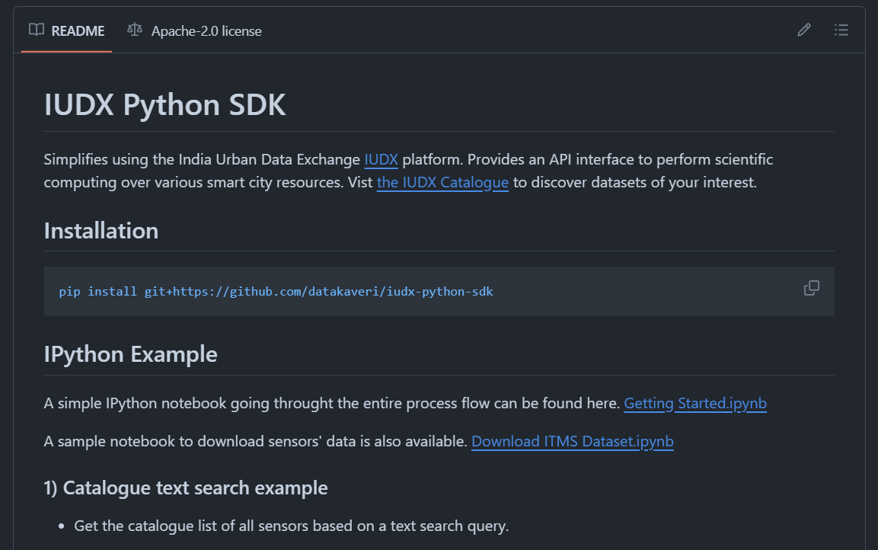
Dataset Resolution

Slide 3
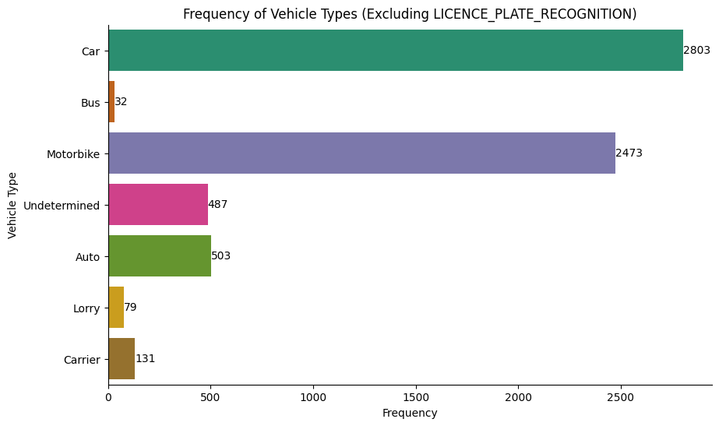
Analyzing Peak Hours (02-04-2024, 8 to 11 AM)

Slide 4
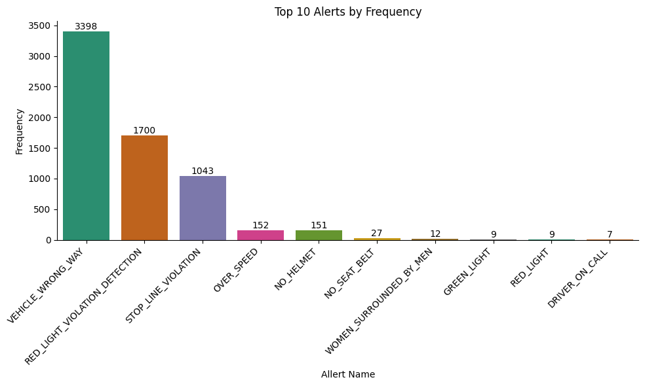
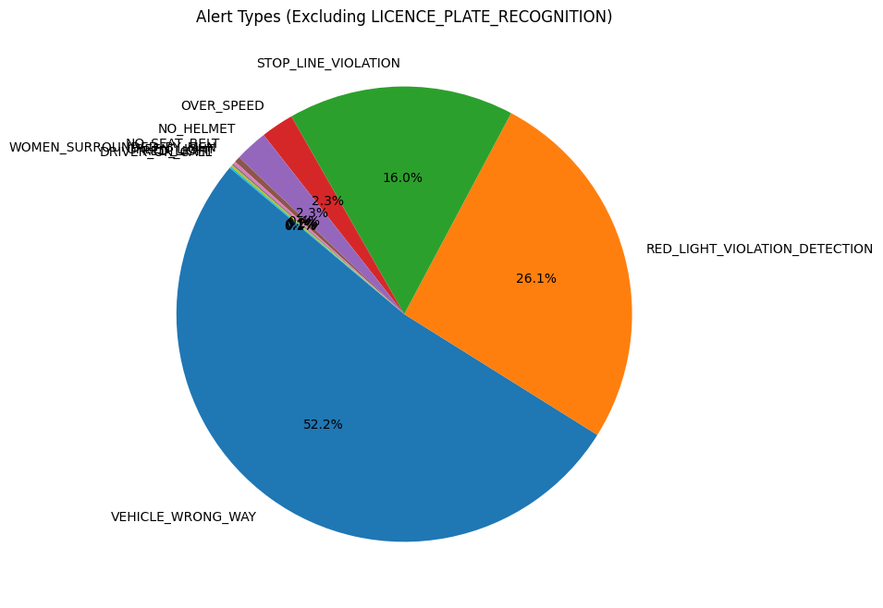
Violation share

Slide 5
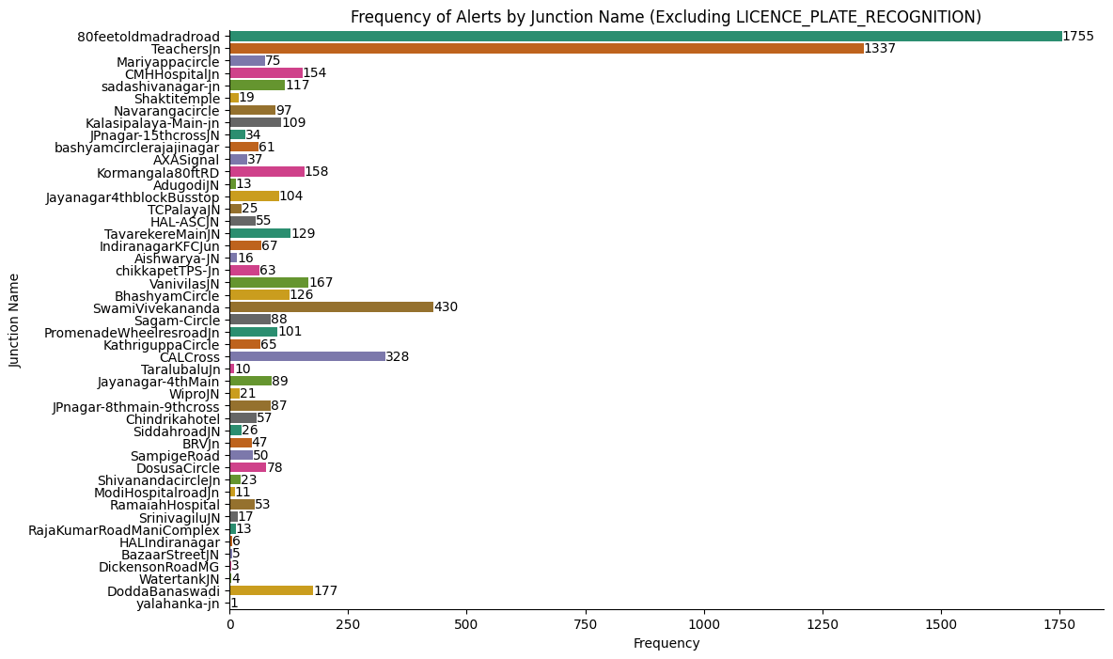
Frequency by Junction

Slide 6
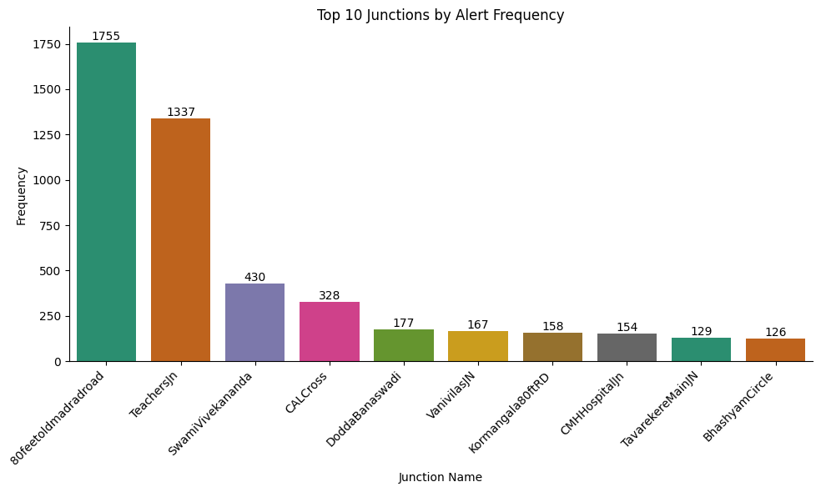
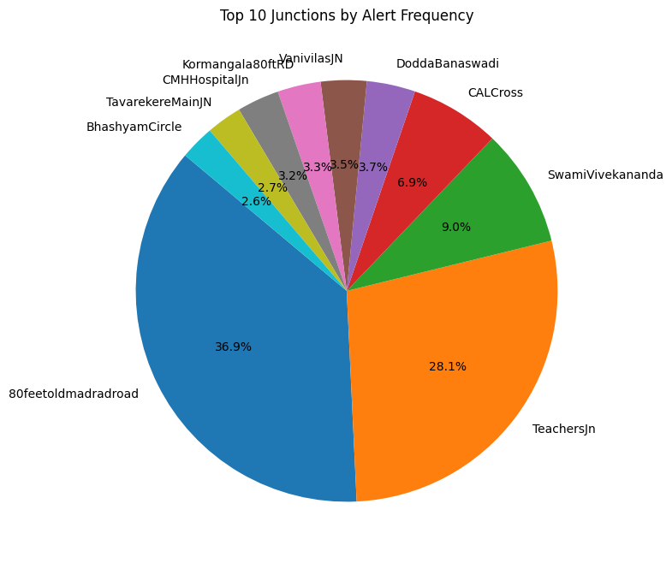

Slide 7
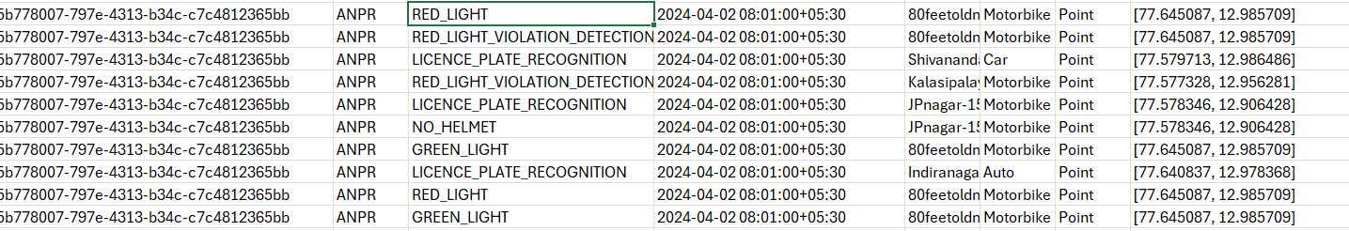
Red Light and Green Light Events

Slide 8
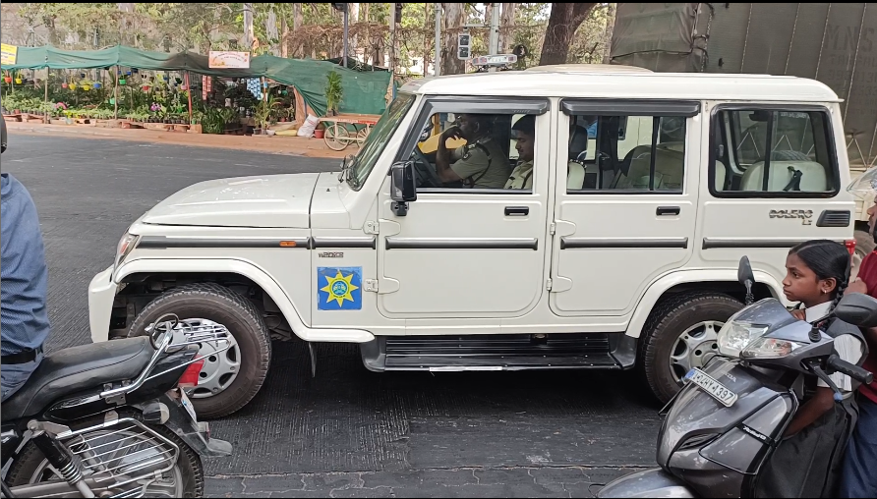
Manual Vlidation
Considered for Time Instant 8:27:29 to 8:28:08 (39 seconds of Red Light at Swami Vivekananda)
RED_LIGHT_VIOLATION count -> 2
STOP_LINE_VIOLATION -> 5

Slide 9
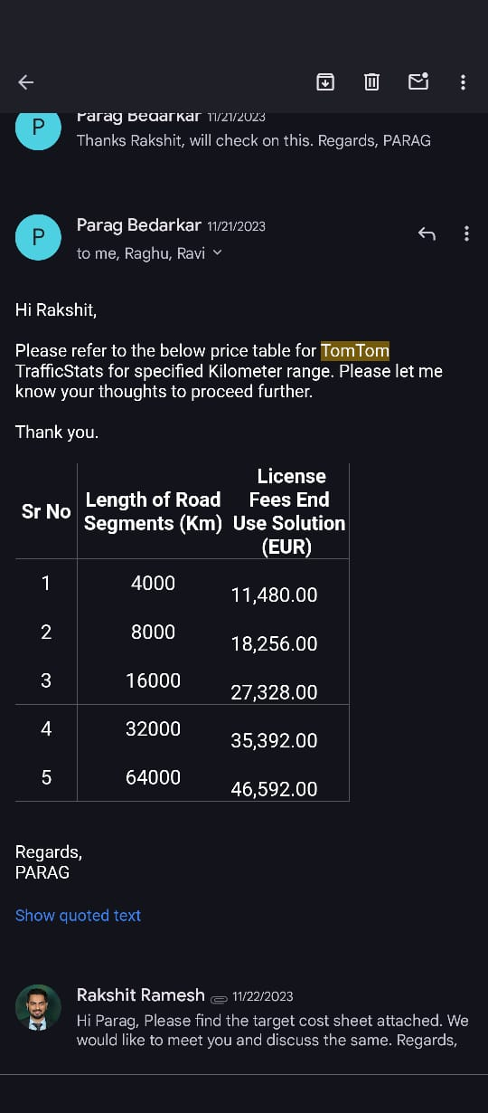
Traffic flow (PCU)

Slide 10
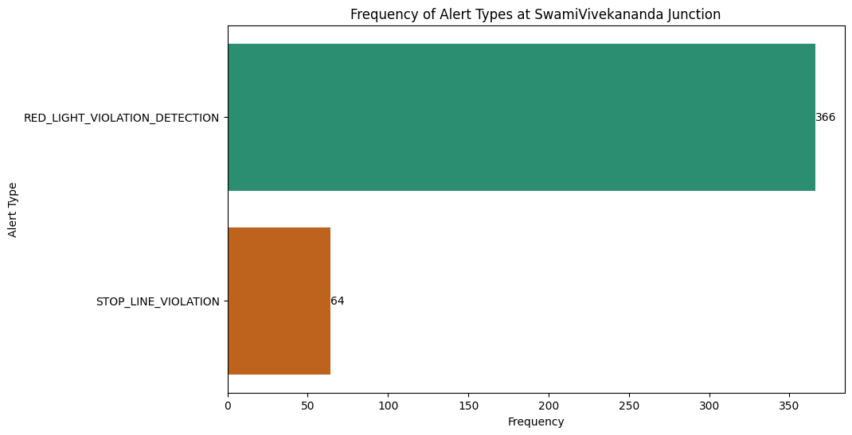
Focusing on SwamiVivekananda

Slide 11
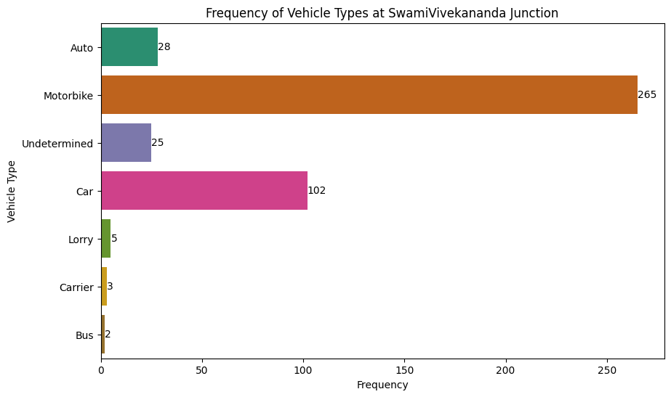
Vehicle Type Analysis

Slide 12
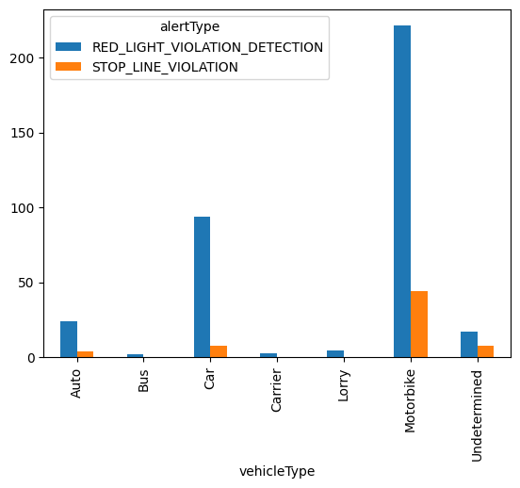
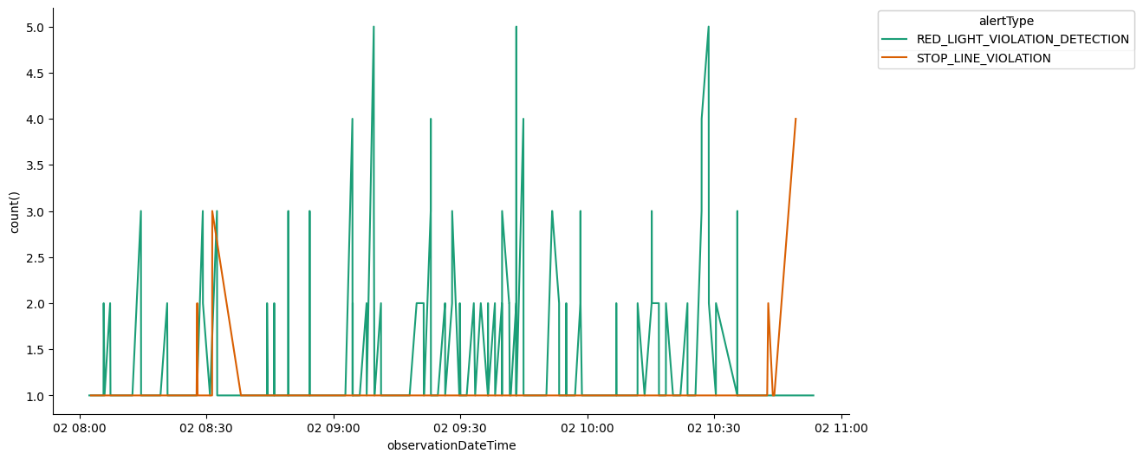
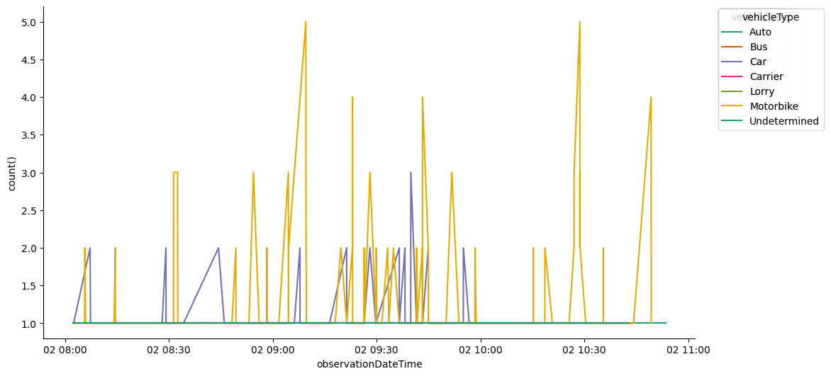

Slide 13
Studies based on CycleLength
A comprehensive study on factors influencing pedestrian signal violation behaviour: Experience from Kolkata City, India (Dipanjan Mukherjee, Sudeshna Mitra)
Influence of Traffic Signal Timing on Red-Light Running and Potential Vehicle Conflicts at Urban Intersections (Richard A. Retting, Michael A. Greene)

